Slide 1
Computer Animation
Betrayal Project
Project Advisors:
Dr. Hussein Alshafie
Dr. Mousa Elkhadr
Project Developers:
Mohamed AbdElrahman Elkhlawy
Waleed AbdElmeged Alassar

Slide 2
Introduction
Project Concept Overview
Welcome to The Betrayal Project – an immersive fusion of visual storytelling and interactive experiences. This project brings together the creative realms of Blender scenes and Python's Tkinter to deliver a captivating narrative.
The Betrayal Project in a Nutshell
Visual Storytelling: Unveil a gripping tale through carefully crafted Blender scenes.
Dynamic Interaction: Engage with the narrative using a user-friendly Tkinter GUI.
Seamless Fusion: Experience the synergy of 3D animation and interactive elements.
Key Highlights
Witness the betrayal unfold through meticulously designed Blender scenes.
Navigate through the storyline effortlessly with the intuitive Tkinter GUI.
Discover a unique blend of artistic expression and user engagement.
Join us on this journey as we explore the convergence of artistry and technology in The Betrayal Project.

Slide 3
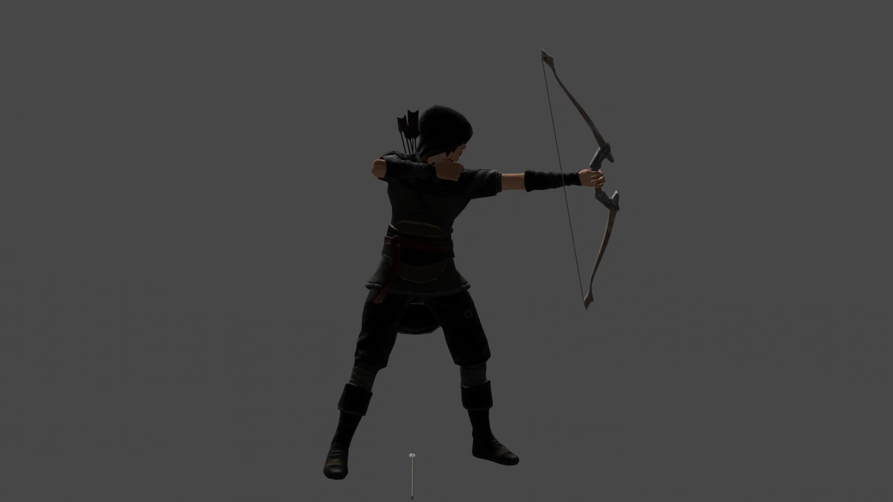
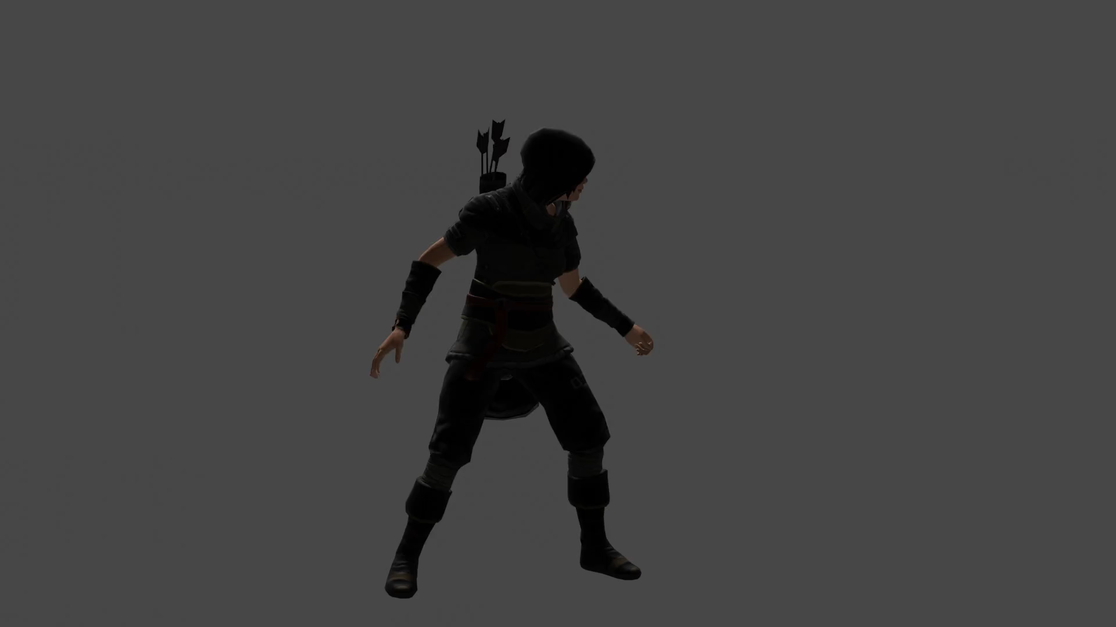
Project Components
Blender Scenes
1. Individual Character Scenes:
Scene 1: The Arc Thrower
Scene 2: The Impact

Slide 4
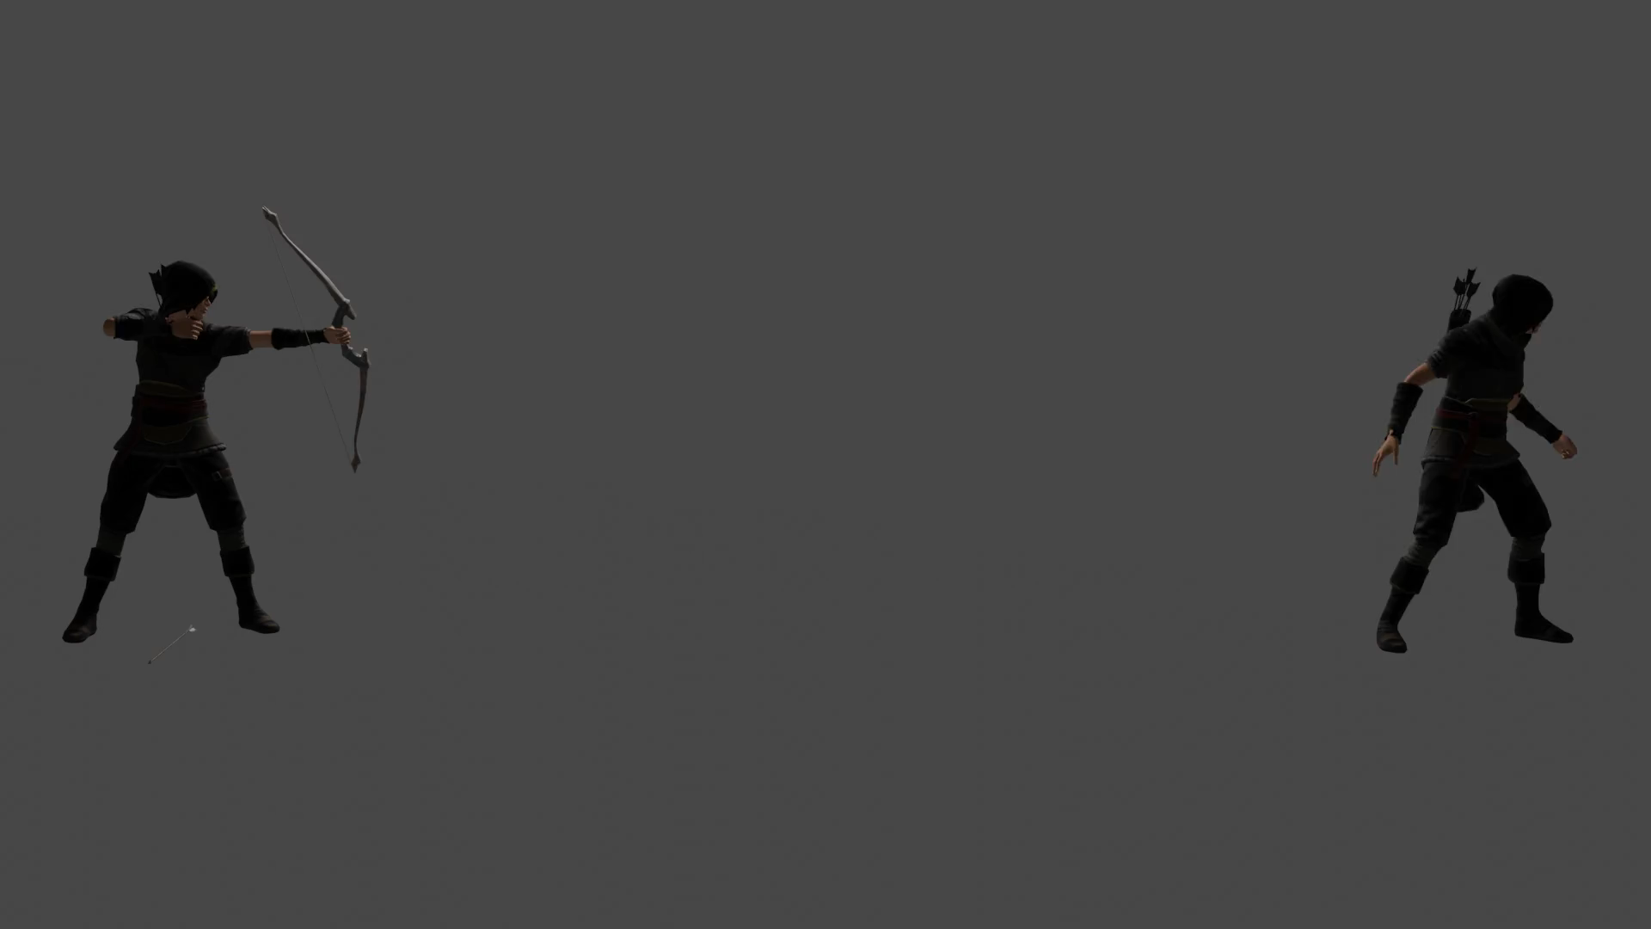
Project Components Con’t
2. Combined Scene: The Betrayal Moment
Scene 3: The Convergence

Slide 5
Python GUI
Tkinter-based GUI Overview
The Heart of Interaction
The Betrayal Project features a user-friendly Python GUI built with Tkinter, enhancing the viewer's control and interaction with the narrative.
Four Buttons for User Interaction
View Individual Scenes:
Discover Characters individually: Navigate through the scenes of Character A and Character B separately.
Immerse in their stories: Witness the individual moments that lead to the betrayal.
View Whole Scene:
Culmination of Betrayal: Experience the betrayal moment with both characters in the same environment.
Captivating Unity: Witness the convergence of the narrative threads in a single, powerful scene.

Slide 6
Python GUI Con’t
Restart GUI:
Seamless Transitions: Reset the GUI for smooth navigation between individual and combined scenes.
Explore at Your Pace: Conveniently restart to explore different facets of the narrative.
Quit:
Graceful Exit: Close the Tkinter window and exit the application effortlessly.
Wrap up the Experience: Use this button when ready to conclude the Betrayal Project interaction.

Slide 7
Conclusion
The Betrayal Project: A Recap
Blender Scenes:
Dive into the meticulously crafted individual character scenes, witnessing the arc throw and its aftermath.
Experience the pinnacle of betrayal as both characters converge in a powerful combined scene.
Python GUI with Tkinter:
Engage seamlessly with the narrative using the user-friendly Tkinter-based GUI.
Navigate effortlessly through scenes, restart for a fresh experience, and gracefully exit the application.
Thank You for Your Attention!
We appreciate your time and involvement in experiencing The Betrayal Project.
Your participation adds to the dynamic fusion of artistry and technology that defines this project.

Slide 8


